Slide 1
Pattern Recognition
Project 1
Lukas Drexler, Leif Van Holland, Reza Jahangiri,
Mark Springer, Maximilian Thiessen

Slide 2

Task 1

Slide 3
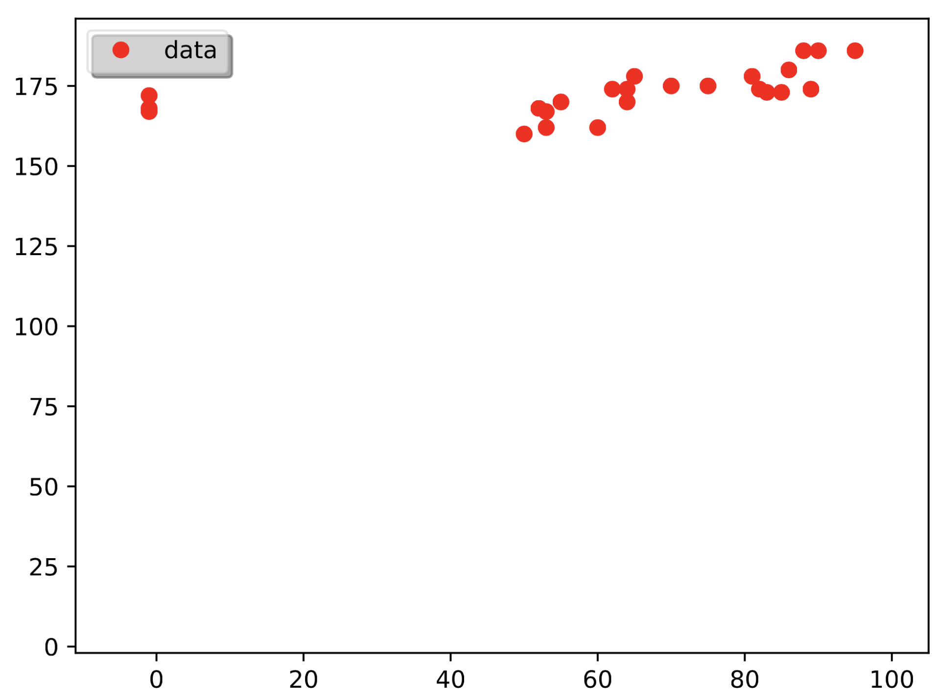
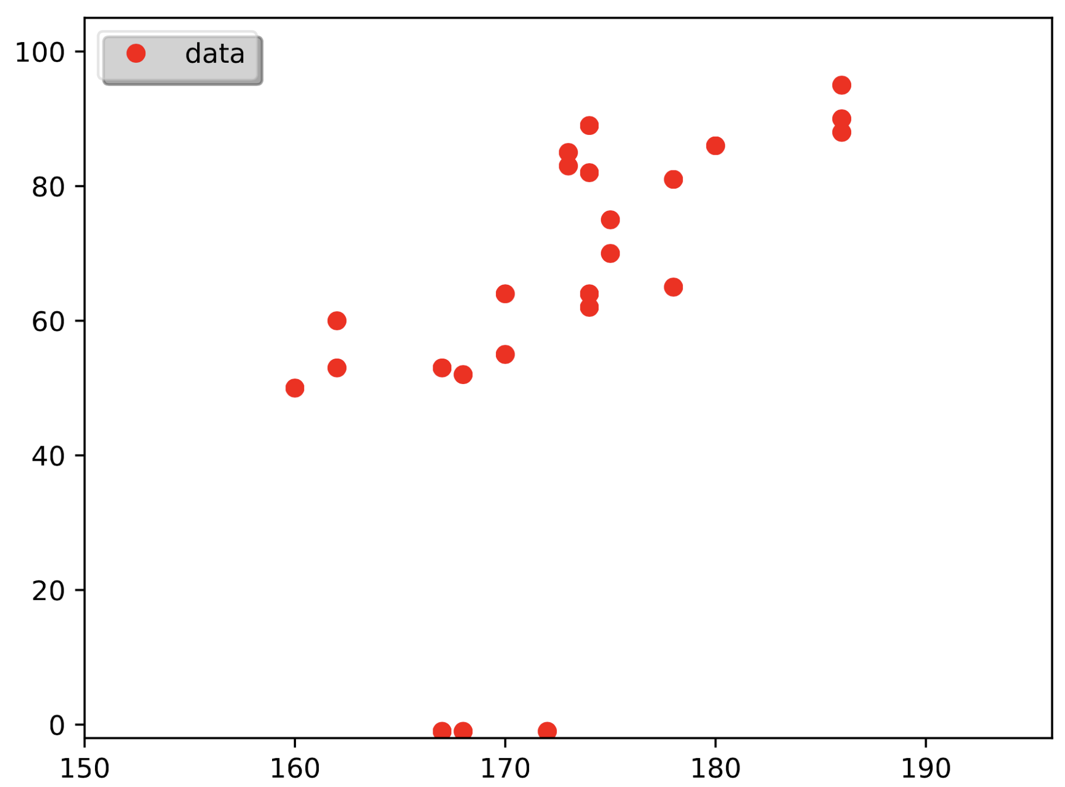
Task 1 – outliers
Task: plot the data without the outliers
weight vs. height
height vs. weight

Slide 4
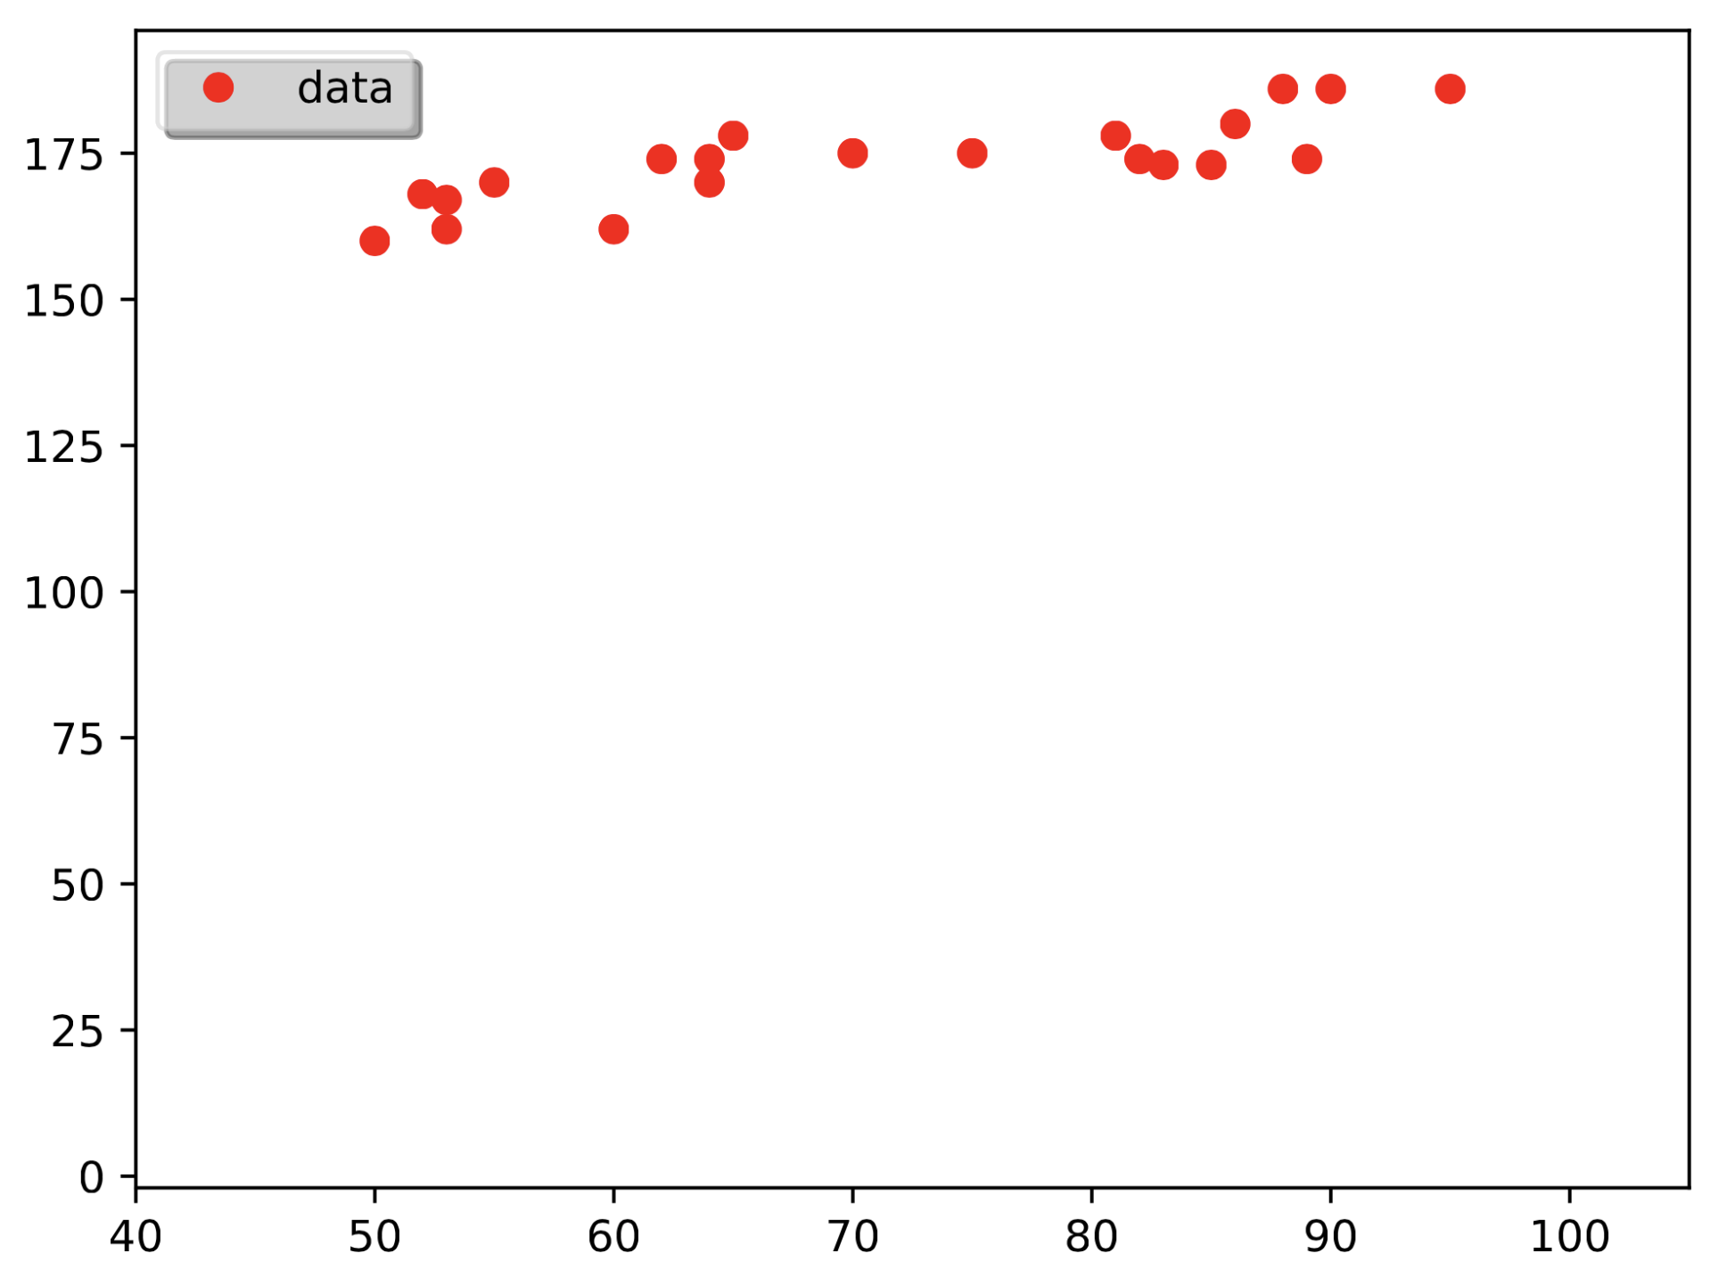
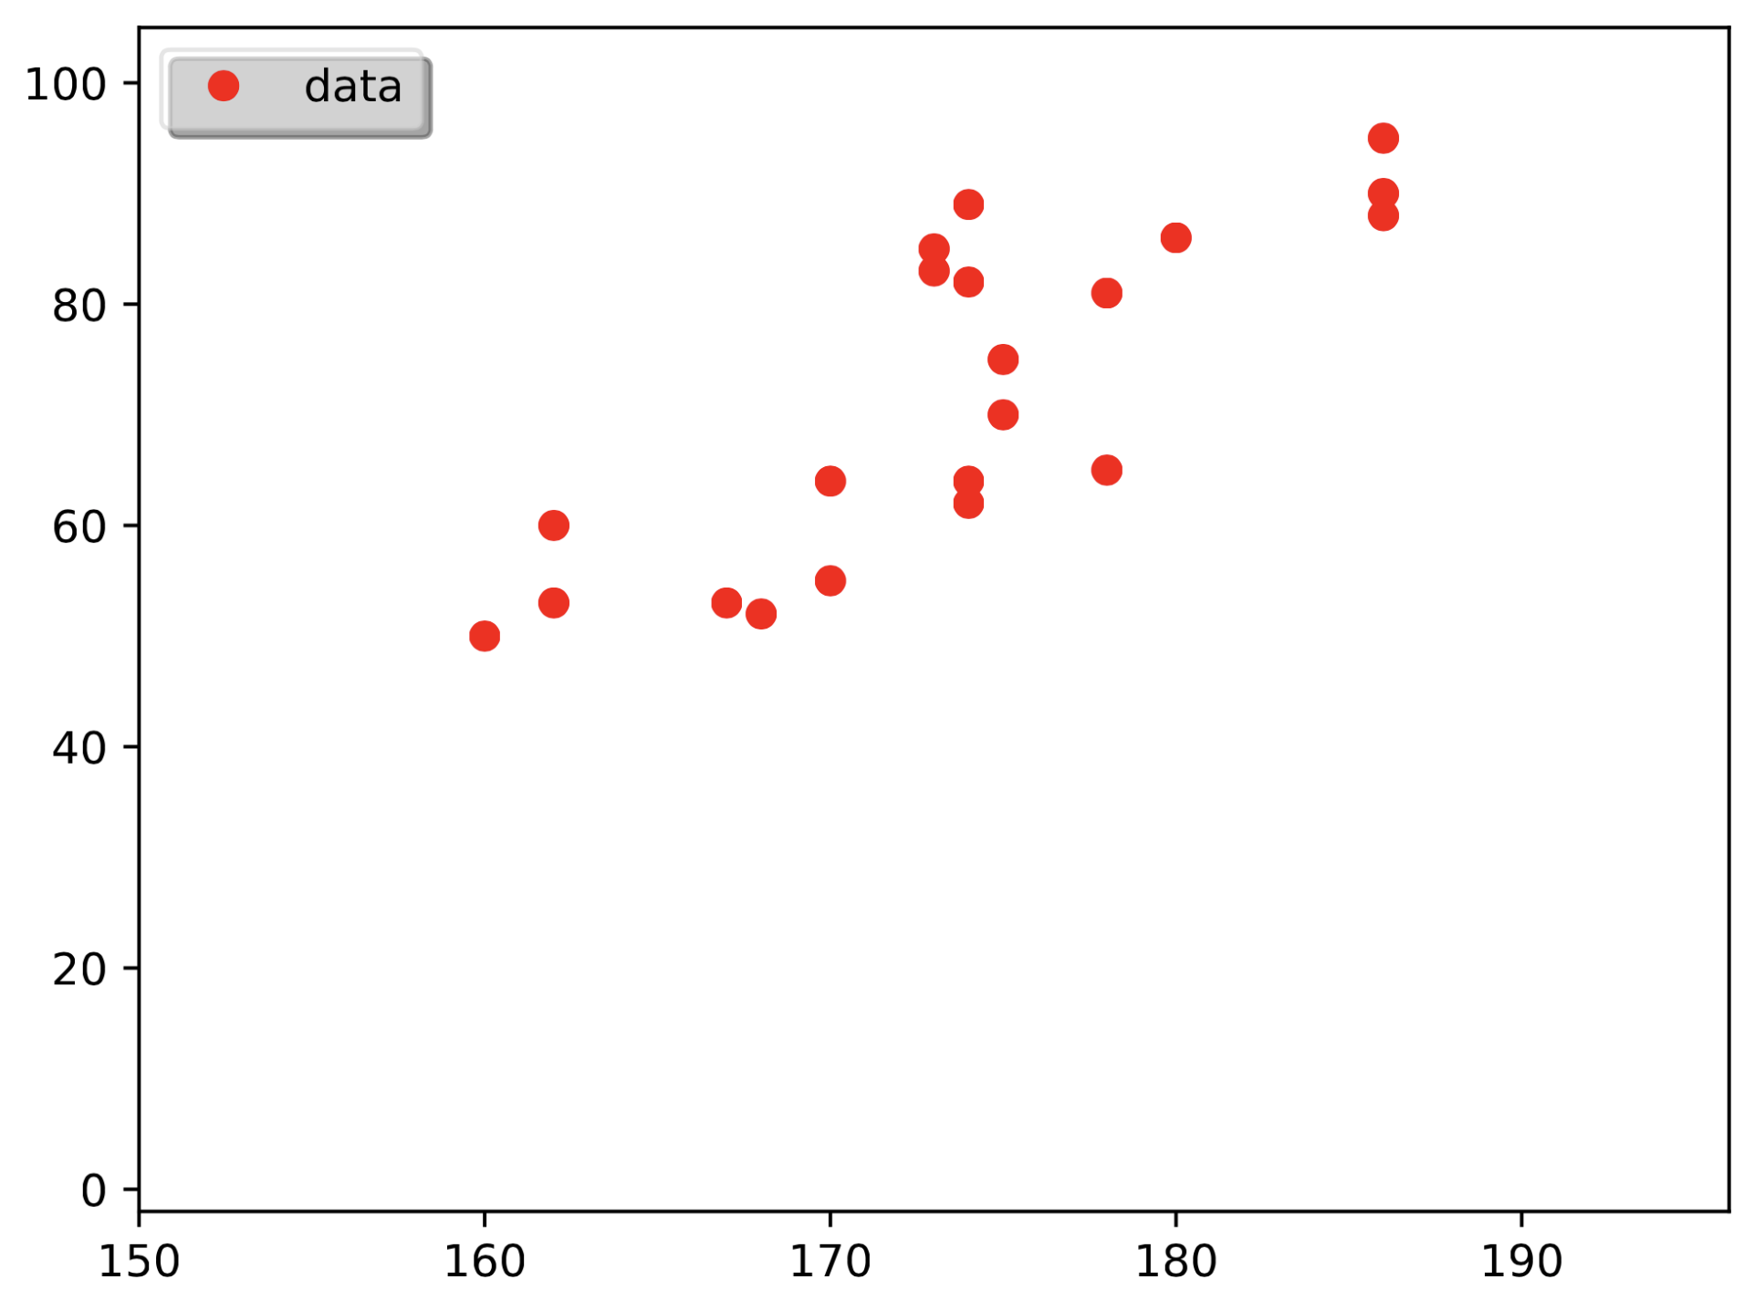
Task 1 – outliers (cont.)
Use np.all to filter out lines with outliers
X = X[np.all(X > 0, axis=1)]
weight vs. height
height vs. weight

Slide 5
Task 2

Slide 6
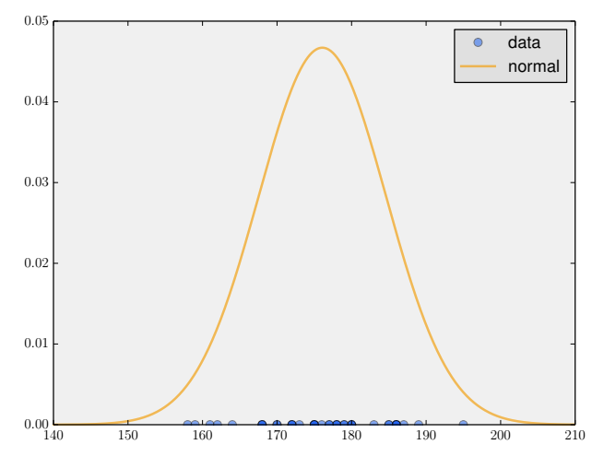
Task 2 – 1D Gaussian
Given 1D array of data
Compute mean
and standard deviation
Plot data and normal distribution characterizing its density

Slide 7
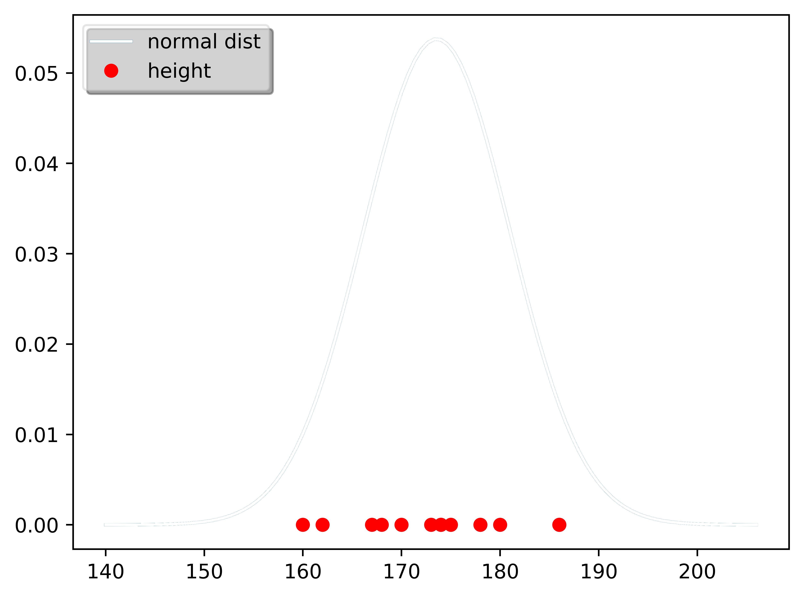
Task 2 – 1D Gaussian (cont.)
mean:
standard deviation:
normal distribution:

Slide 8
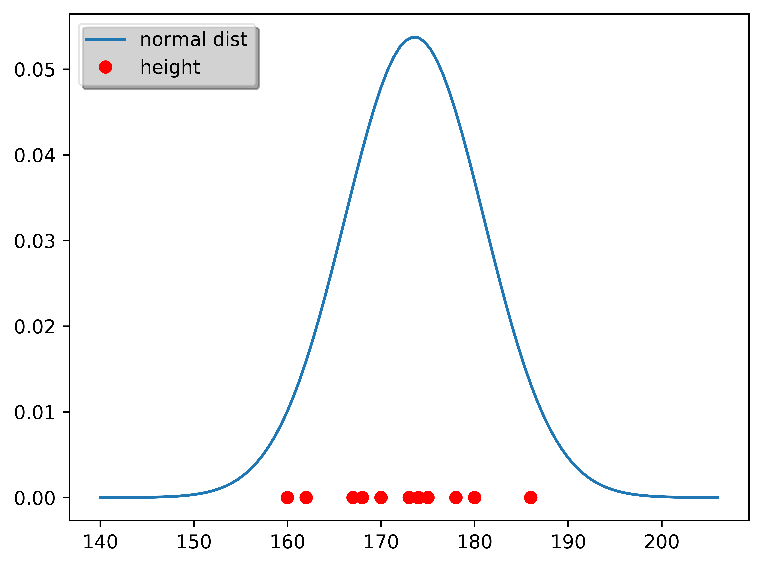
Task 2 – 1D Gaussian (cont.)
mean:
standard deviation:
normal distribution:

Slide 9
Task 3

Slide 10
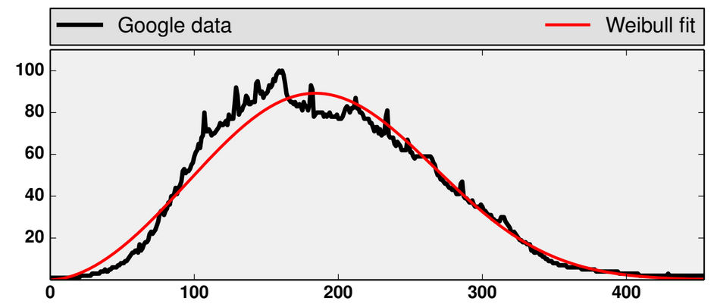
Task 3
Fit weibull distribution
to given data
Estimate parameters
and by
maximum likelihood

Slide 11
Task 3 – using the histogram
For a dataset consider its histogram
Using the histogram:

Slide 12
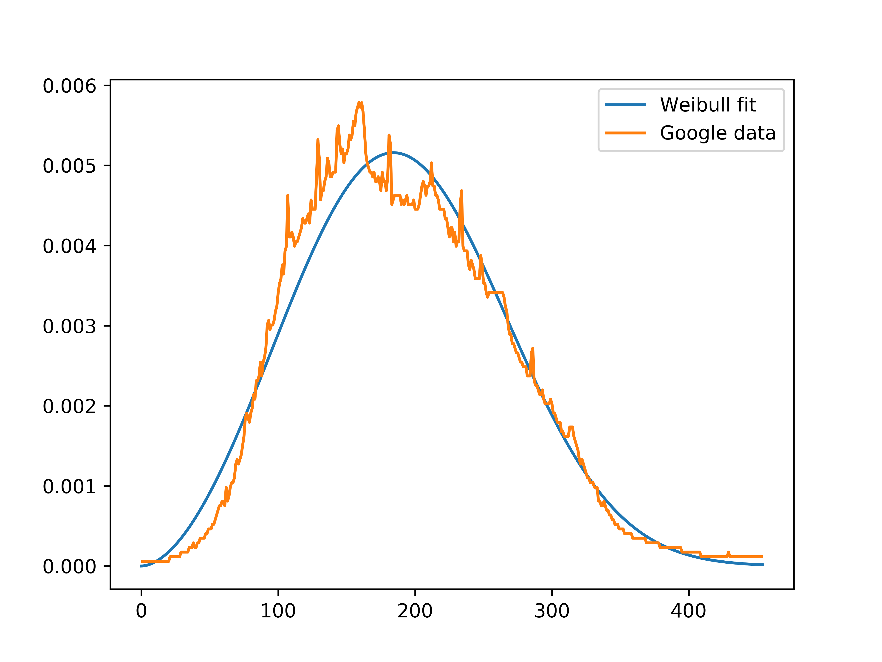
Task 3 – Newton’s method
Estimate parameters using
Newton’s method for
partial derivatives of

Slide 13
Task 3 – solving via odeint
odeint solves ODEs in the form
Consider ODE for a function
Let
We get

Slide 14
Task 3 – odeint ≈ Euler
Assuming odeint does something like the Euler method
For step size and evenly spaced values
Method eventually settles in a local optimum
For we found same optimum as before

Slide 15
4. Task

Slide 16
Exercise 5

